Slide 1

Telecom Customer Churn Analysis
- Sanskriti Rai

Slide 2

Predictive Analytics & Strategic Insights
Project Overview
Objective: Analyze and predict customer churn in telecom services
Dataset: Customer behavior and service usage metrics
Business Value: Identify at-risk customers and develop targeted retention strategies

Slide 3

Dataset Description
Anonymous Customer ID: Unique identifier for each customer
Call Failures: Number of dropped/failed calls
Complains: Binary (0: No complaint, 1: Complaint)
Subscription Length: Total months of subscription
Charge Amount: Ordinal (0: Lowest, 9: Highest)
Seconds of Use: Total duration of calls
Frequency of Use: Total number of calls
Frequency of SMS: Total number of text messages
Distinct Called Numbers: Unique numbers called
Age Group: Ordinal (1: Younger, 5: Older)
Tariff Plan: Binary (1: Pay-as-you-go, 2: Contractual)
Status: Binary (1: Active, 2: Non-active)
Customer Value: Calculated customer value
Churn: Binary (0: Retained, 1: Churned) - Target variable

Slide 4
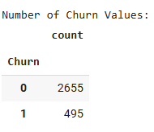
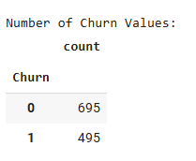
Data Exploration
Balanced dataset of telecom customers (695 non-churned, 495 churned)
SQL database creation for aggregation queries
Key metrics tracked:
Customer value
Subscription length
Usage patterns (seconds of use)
Complaints
Call failures
Service usage frequency

Slide 5
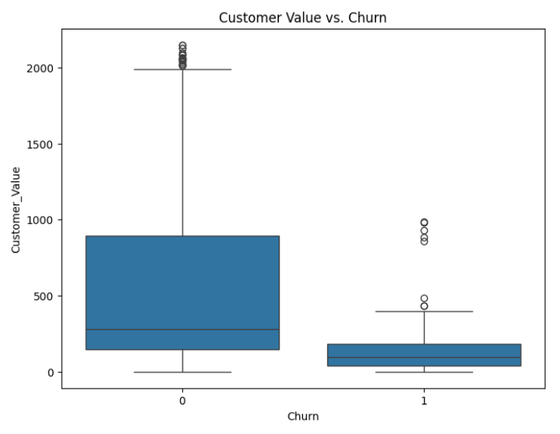
Customer Value vs. Churn
Insights:
Non-churned customers (0) show significantly higher customer value
Churned customers (1) cluster around lower value points
Customer value is a strong indicator of retention likelihood

Slide 6
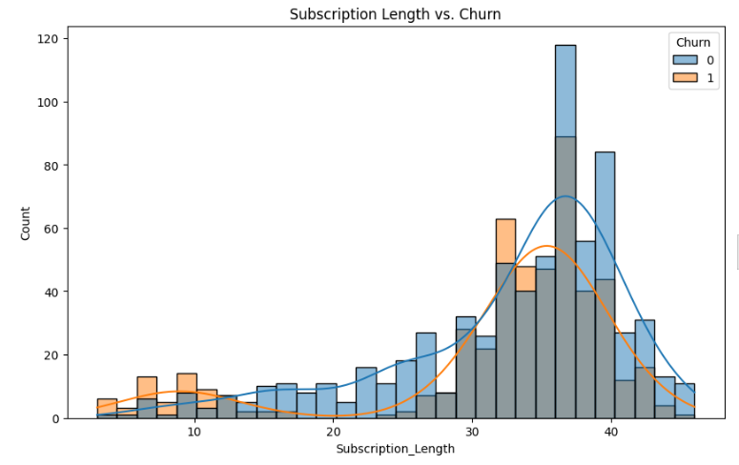
Subscription Length Patterns
Insights:
Early subscription months (5-15) show elevated churn risk
Peak retention occurs around 35-40 months
Two distinct customer lifecycle phases visible in the data

Slide 7
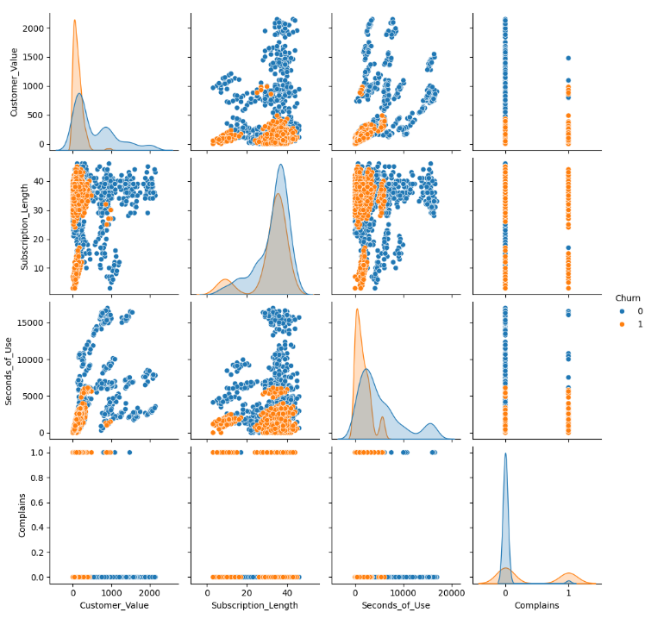
Usage Behavior
Insights:
Churned customers predominantly show low usage (<2500 seconds)
Non-churned customers display more varied usage patterns
High usage (>10,000 seconds) strongly correlates with retention

Slide 8
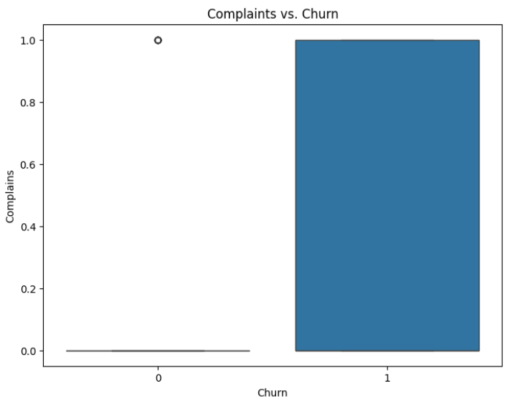
Complaints Impact
Insights:
Strong positive correlation between complaints and churn
Almost binary relationship - customers with complaints show remarkably higher churn rates
Critical intervention point for retention strategies

Slide 9
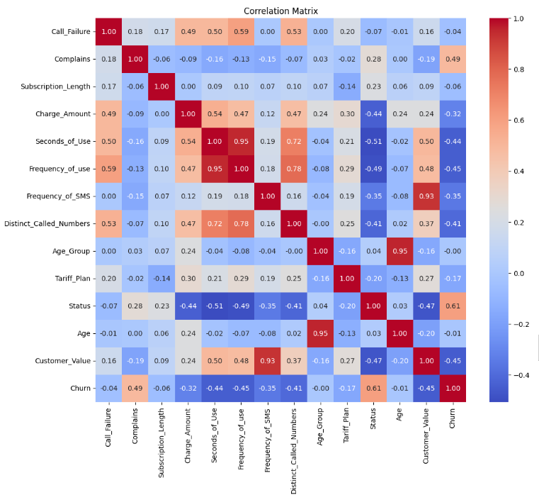
Correlation Analysis
Strongest Correlations with Churn:
Status (0.61)
Complaints (0.49)
Frequency of Use (-0.45)
Customer Value (-0.45)
Seconds of Use (-0.44)

Slide 10
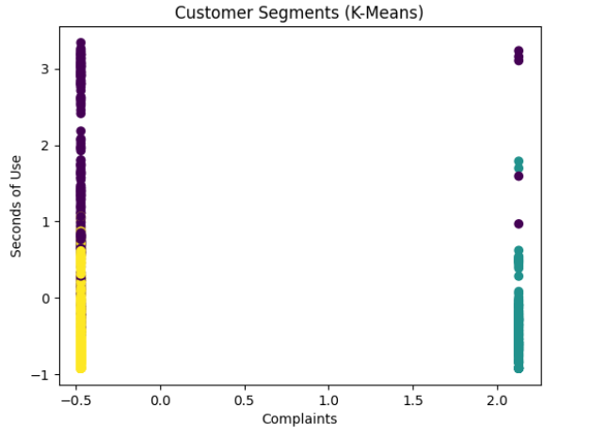
Customer Segmentation (K-Means)
3 Distinct Customer Segments:
High-Value Users: High usage, few complaints, long subscriptions
At-Risk Users: Low usage, higher complaints, shorter subscriptions
Moderate Users: Medium usage, varied complaint levels

Slide 11
Machine Learning Performance
Random Forest Classification:
Precision: 97%
Recall: 95%
F1-Score: 96%
ROC-AUC: 0.99
Decision Tree Classification:
Precision: 94%
Recall: 97%
F1-Score: 96%
ROC-AUC: 0.95

Slide 12
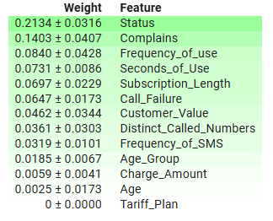
Feature Importance
Top Churn Predictors:
Status (0.21) - Active/Non-active status
Complaints (0.14) - Customer complaint history
Frequency of Use (0.08) - Call volume
Seconds of Use (0.07) - Call duration
Subscription Length (0.07) - Tenure

Slide 13
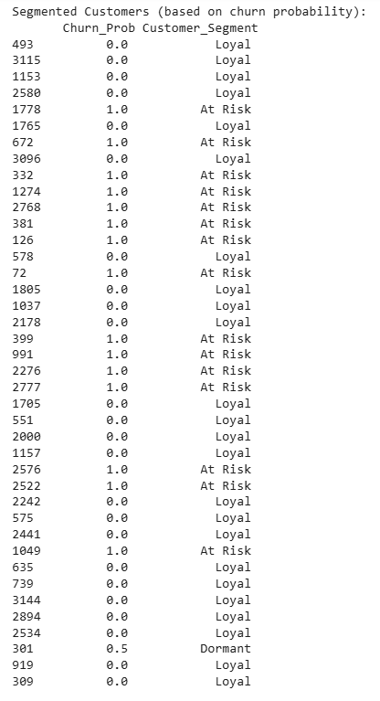
Risk Segmentation Framework
Customer Risk Categories for First 50 Rows:
High Risk (>75% churn probability): Immediate intervention
Medium Risk (25-75% churn probability): Proactive engagement
Low Risk (<25% churn probability): Value enhancement

Slide 14
Actionable Recommendations
1. Complaint Resolution Enhancement
Implement 24-hour complaint resolution guarantee
Develop post-resolution satisfaction tracking
2. Usage-Based Interventions
Create targeted offers for customers with <2500 seconds monthly usage
Develop service packages optimized for low-usage customers
3. Subscription Milestone Program
Deploy special retention offers at months 10-15
Implement loyalty rewards at 12, 24, and 36-month milestones
4. Tariff Plan Optimization
Review contractual vs. pay-as-you-go performance
Develop guided migration paths between plans

